Slide 1
Assignment – 5 (S3, EBS Volumes)
S3, EBS & IAM Practical
Create S3 bucket
Do hands-on on S3 properties
Bucket Versioning
Server access logging
AWS CloudTrail data events
Static website hosting (including permission) [ref. - https://www.w3schools.com/html/]
Create Lifecycle rules
Do EBS practical mentioned in doc “Volume-extend-aws.doc”.
Create new EBS volume
Assign it to server
Format volume
Mount temporary and permanent both.
Extend both data and root volume
Create IAM group, users, policy, AWSCLI users, roles and test the access.
Create AWSCLI user and configure awscli and test all commands mentioned in document.

Slide 2
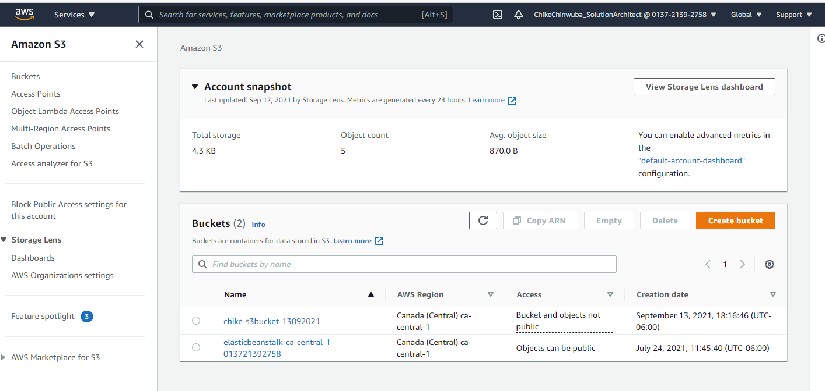
S3 Bucket

Slide 3
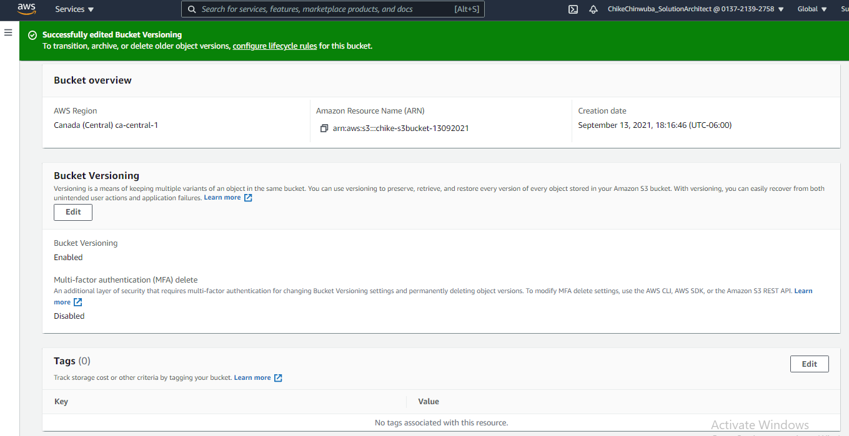
Versioning enabled

Slide 4
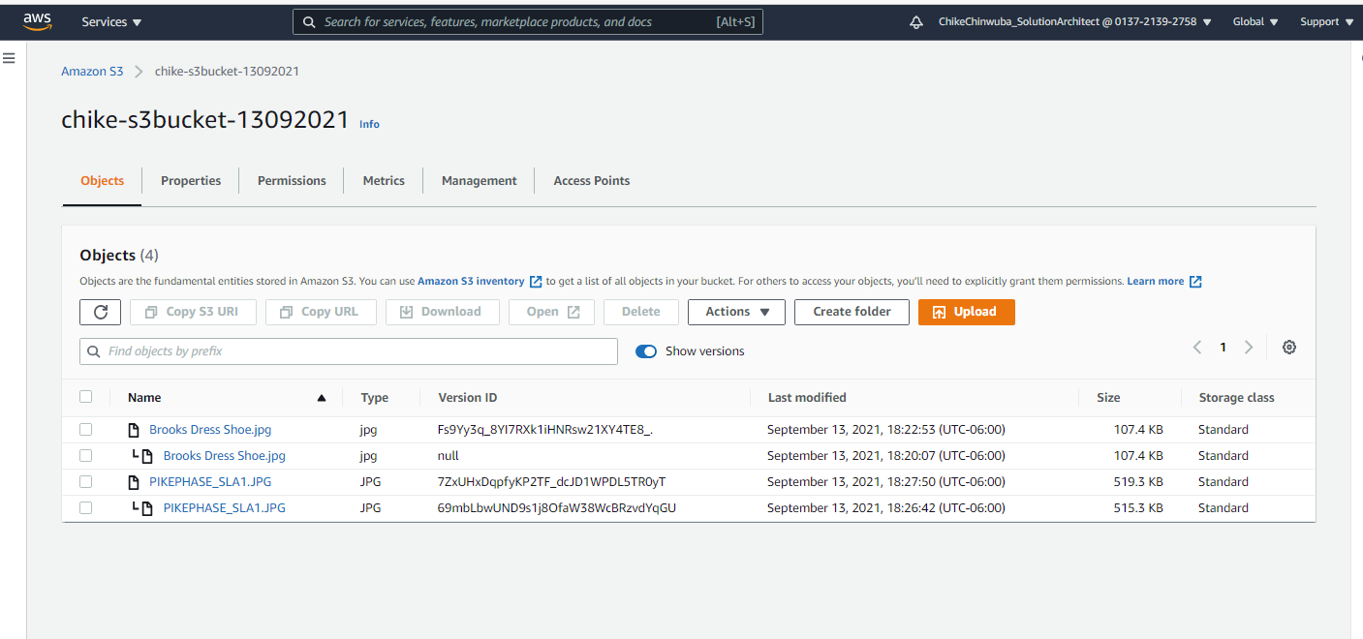
Files with versions

Slide 5
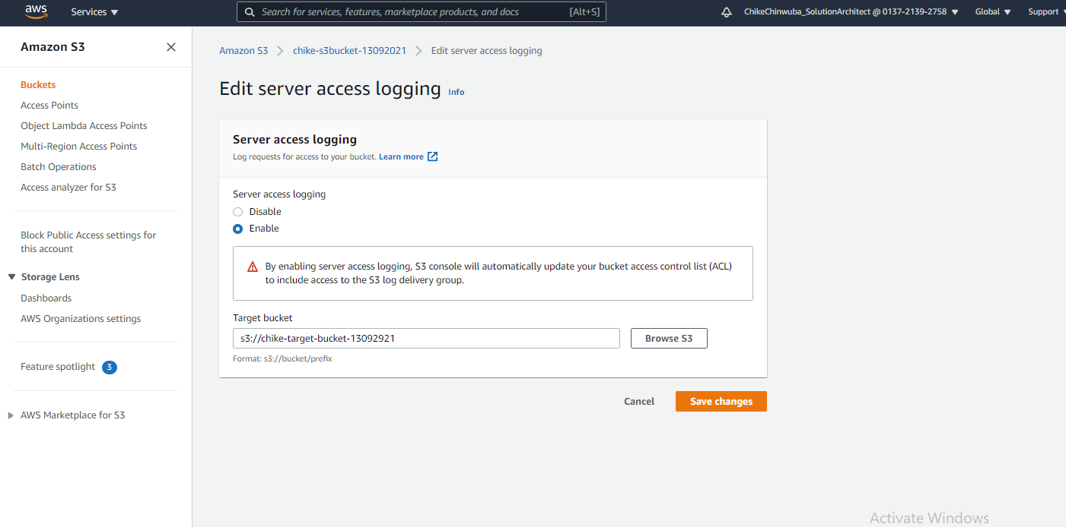
Enabled Server access logging

Slide 6
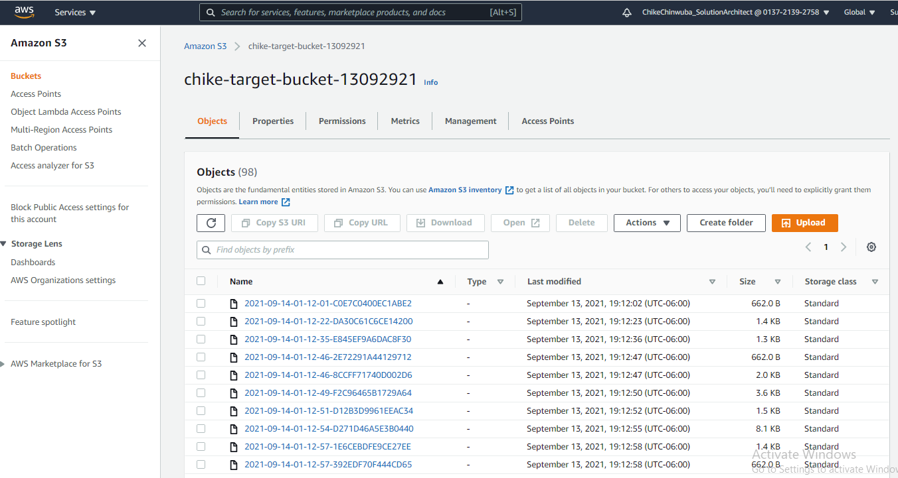
Server access log files

Slide 7
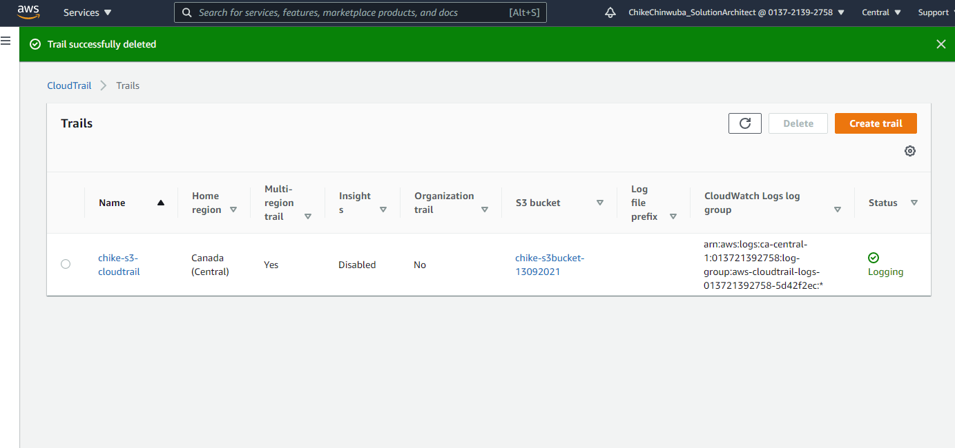
Cloudtrail Created

Slide 8
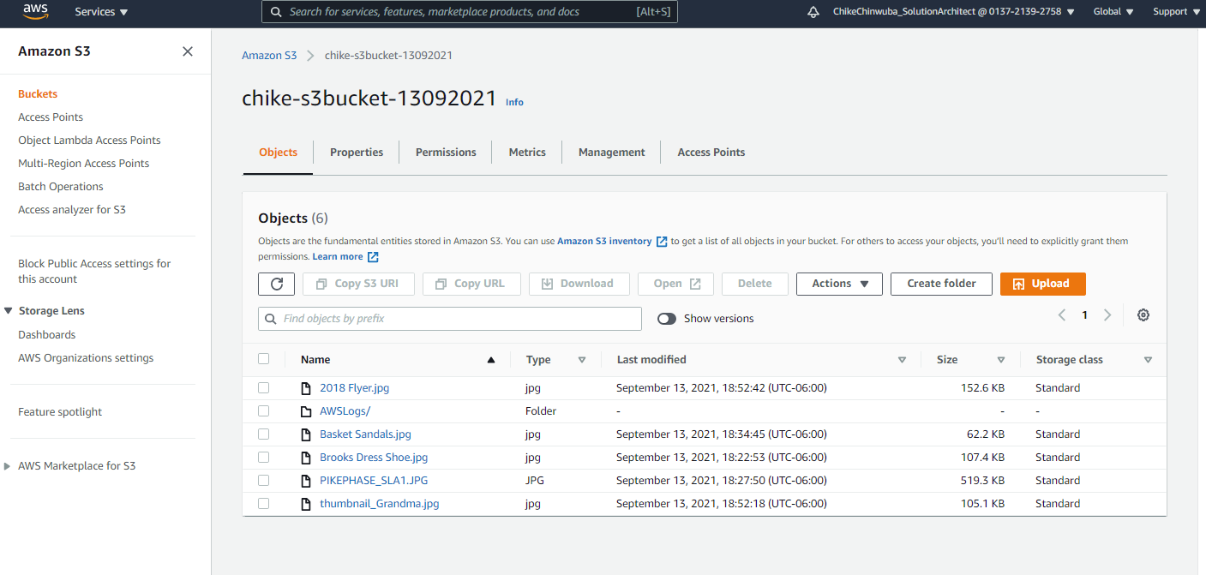
Cloudtrail Log Trail

Slide 9
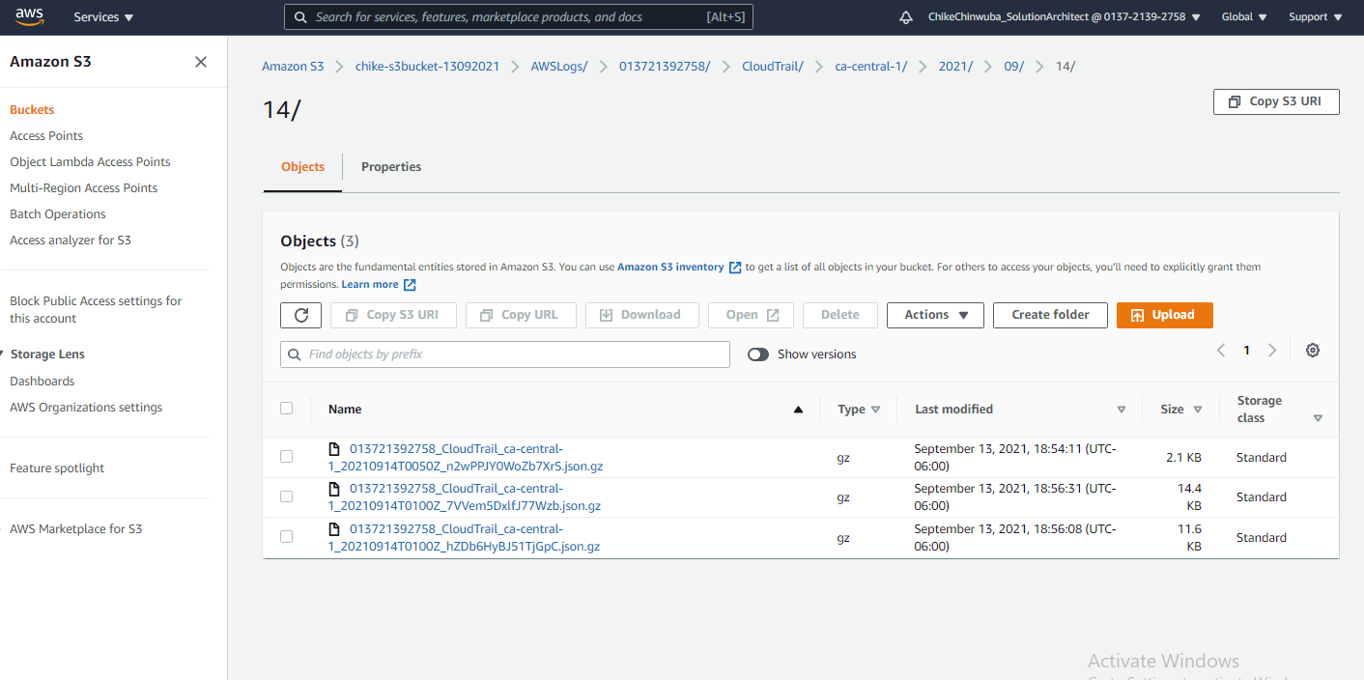
Cloudtrail Log Trail directory - trails

Slide 10
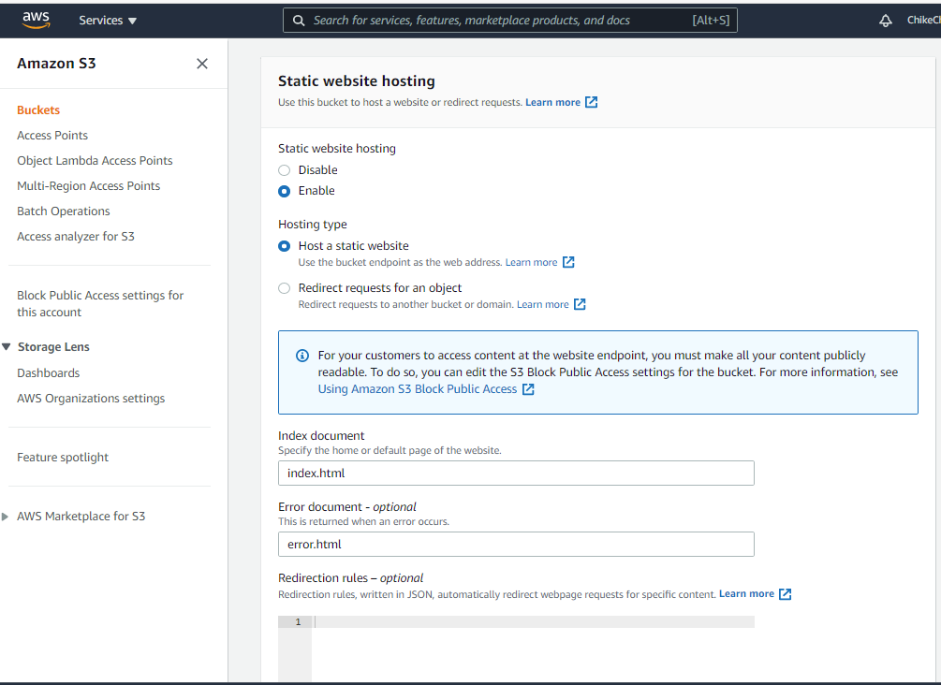
Index html & error.html files

Slide 11
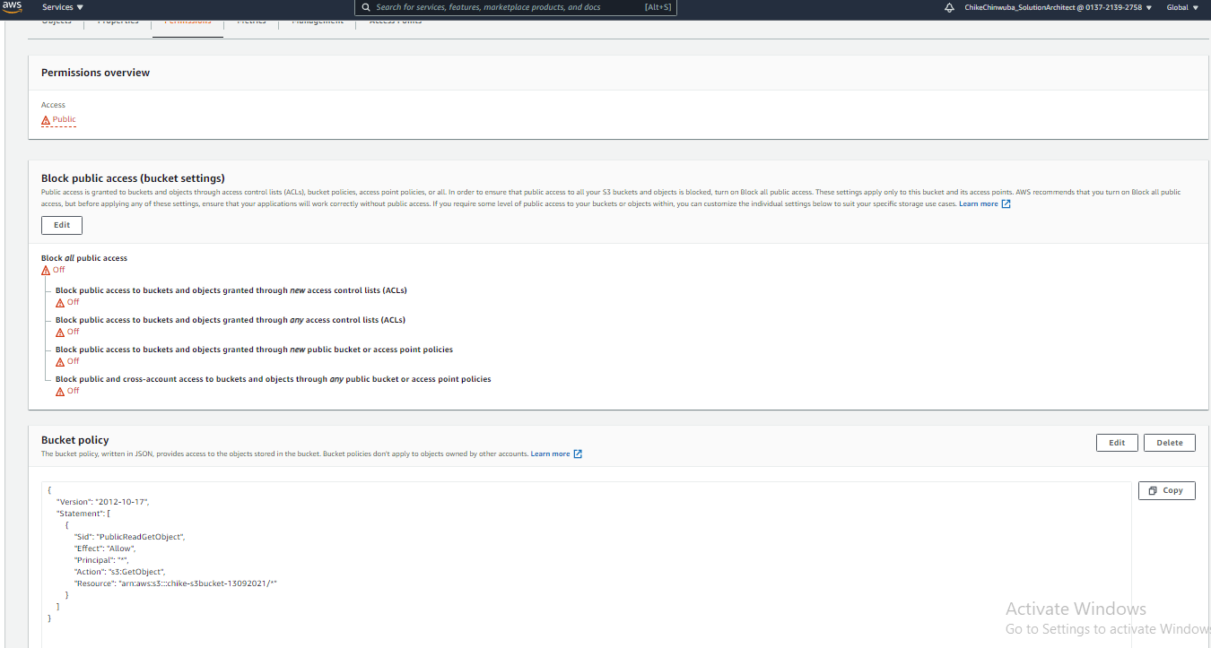
Public access and Bucket policy access

Slide 12

Static website S3 end point connection

Slide 13
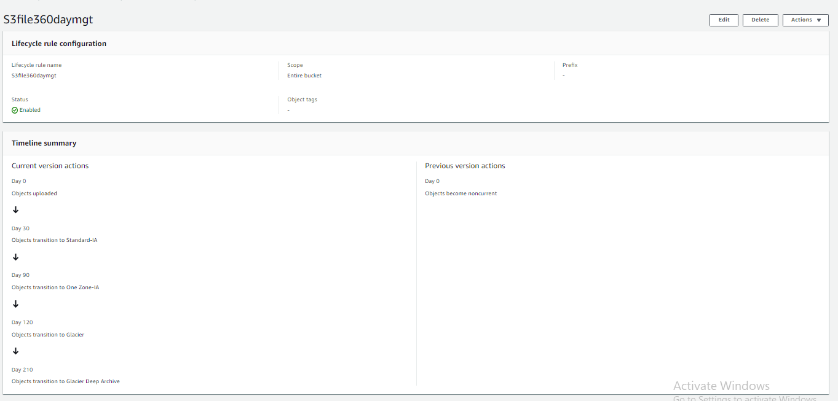
S3 Life cycle Management

Slide 14
S3, EBS & IAM Practical
Create S3 bucket
Do hands-on on S3 properties
Bucket Versioning
Server access logging
AWS CloudTrail data events
Static website hosting (including permission) [ref. - https://www.w3schools.com/html/]
Create Lifecycle rules
Do EBS practical mentioned in doc “Volume-extend-aws.doc”.
Create new EBS volume
Assign it to server
Format volume
Mount temporary and permanent both.
Extend both data and root volume
Create IAM group, users, policy, AWSCLI users, roles and test the access.
Create AWSCLI user and configure awscli and test all commands mentioned in document.

Slide 15
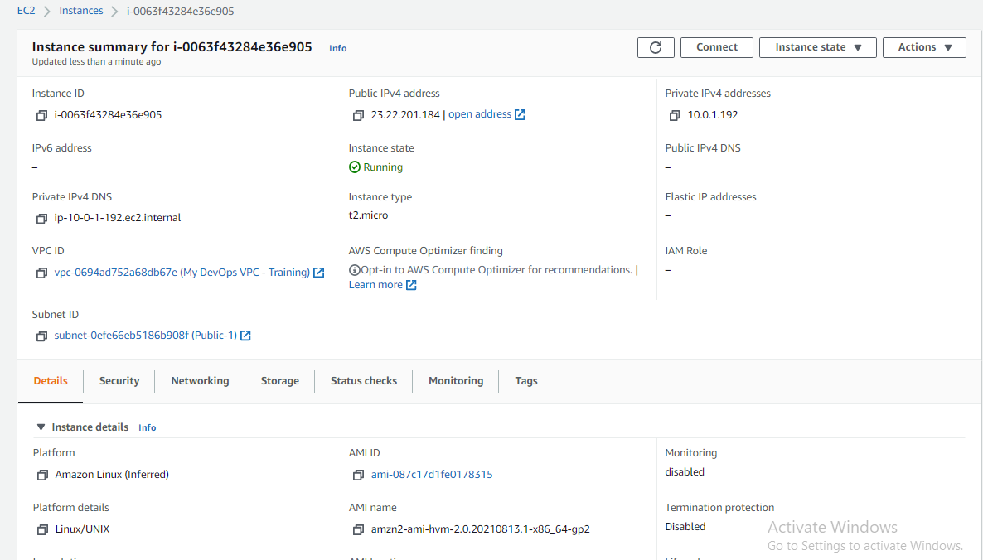
EC2 Public – Private IP:10.0.1.192

Slide 16

CLI – EC2 Server

Slide 17

Fdisk -l

Slide 18
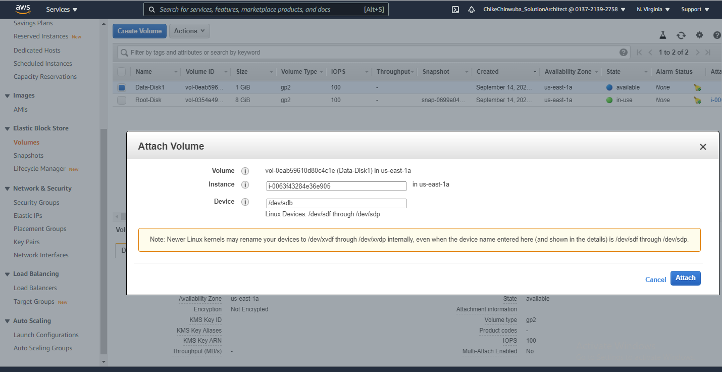
Attach 1GB

Slide 19
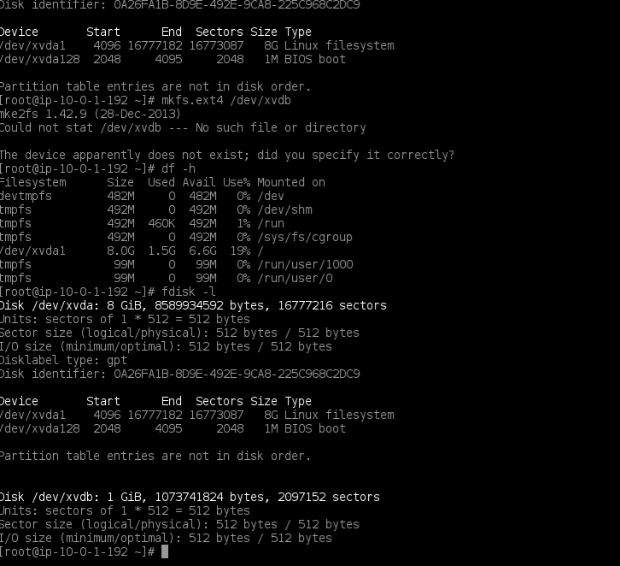
Formatted - 1GB

Slide 20

Mounted on /data

Slide 21

File on data

Slide 22

Permanent Mount

Slide 23
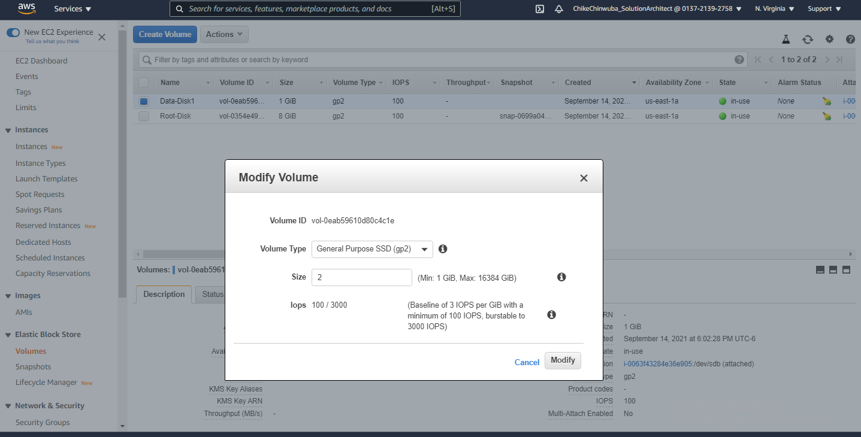
Modify volume to 2GB

Slide 24
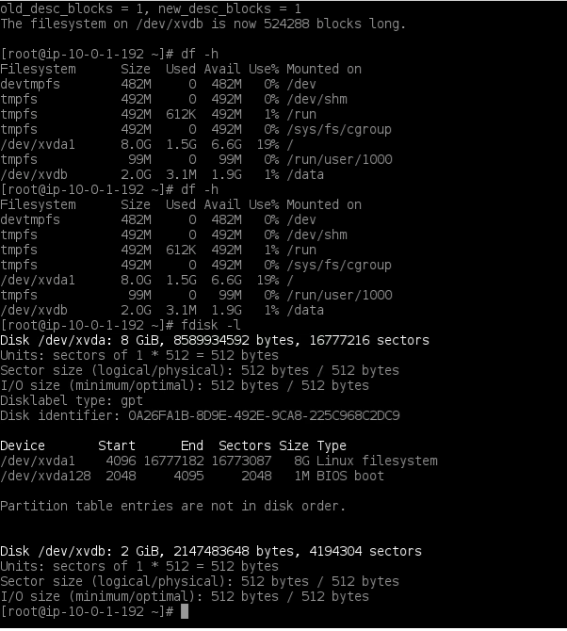
Fdisk –l & dh -f

Slide 25
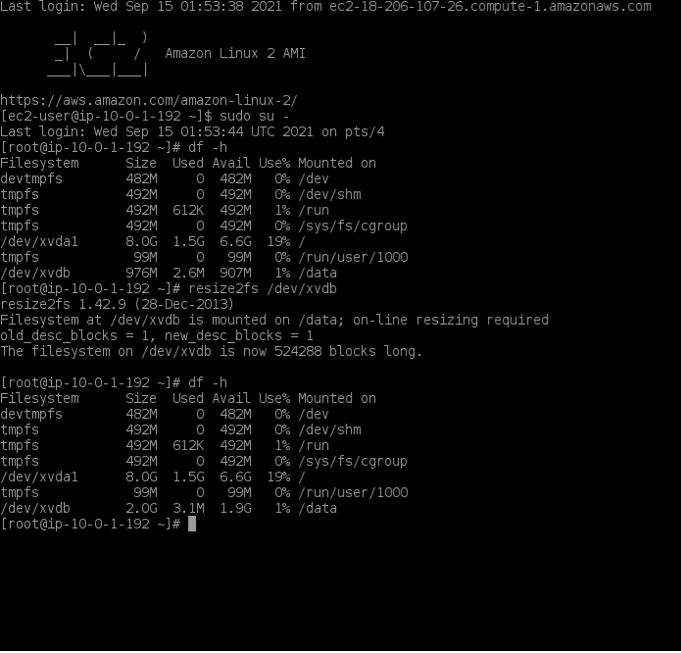
Resized volumes

